Slide 1

Instruction Sets: Characteristics and Functions
Diadaptasi dari
Chapter 10
William Stallings Computer Organization and Architecture 8th Edition

Slide 2

Pertemuan minggu 8 sesi 2
Jenis operand
ENDIAN
Tipe operasi

Slide 3
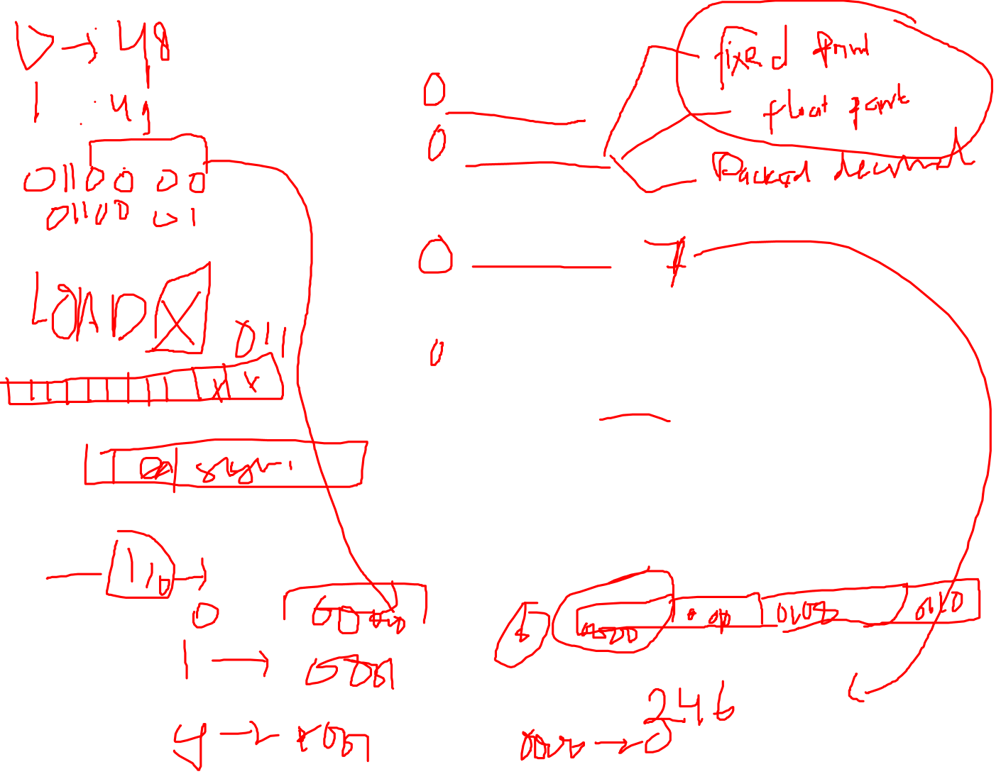
Types of Operand
Addresses
Numbers
Integer/floating point
Characters
ASCII etc.
Logical Data
Bits or flags
(Aside: Is there any difference between numbers and characters? Ask a C programmer!)
Notes:
14

Slide 4
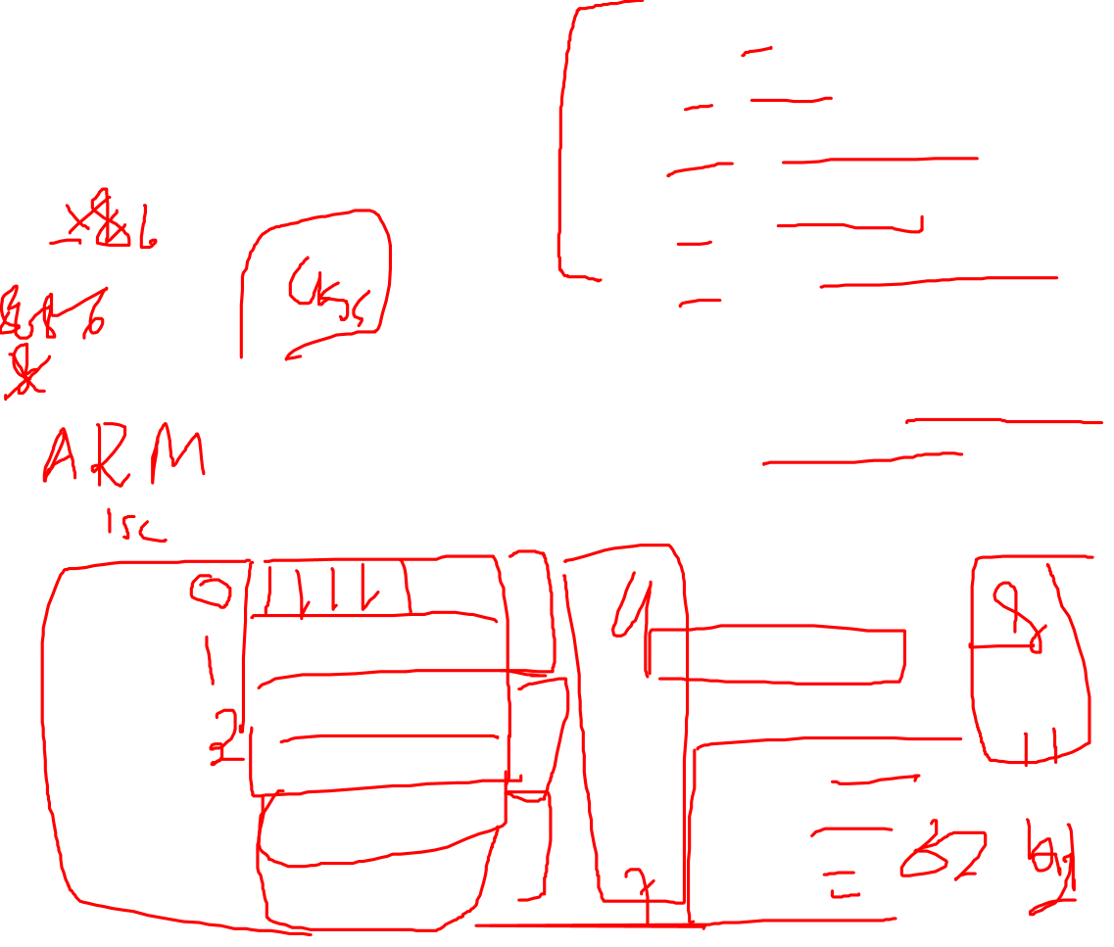
x86 Data Types
8 bit Byte
16 bit word
32 bit double word
64 bit quad word
128 bit double quadword
Addressing is by 8 bit unit
Words do not need to align at even-numbered address
Data accessed across 32 bit bus in units of double word read at addresses divisible by 4
Little endian
Notes:
15

Slide 5
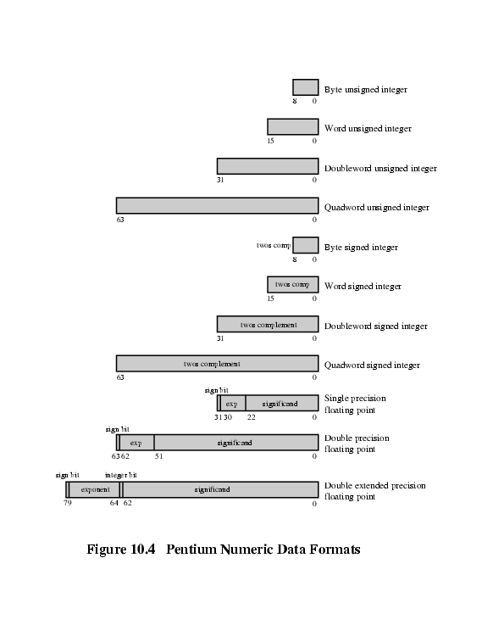
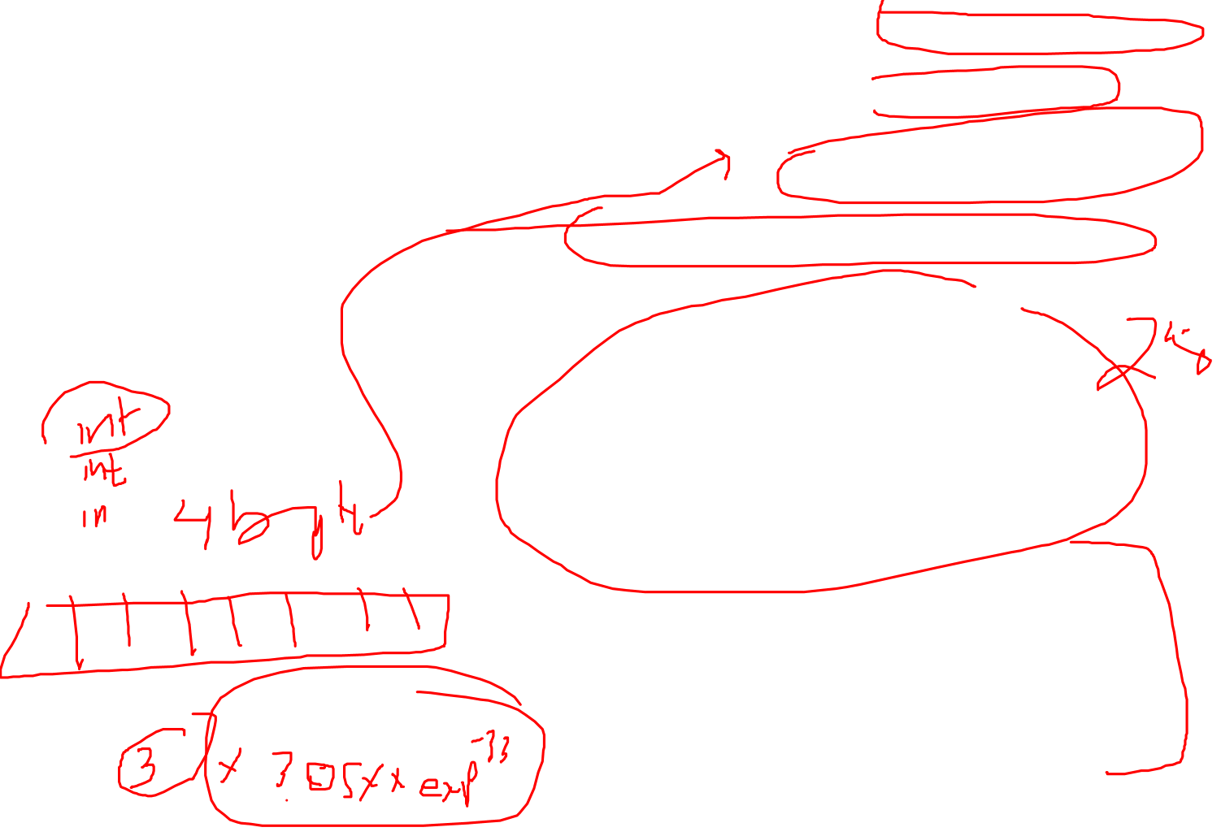
x86 Numeric Data Formats
Notes:
17

Slide 6
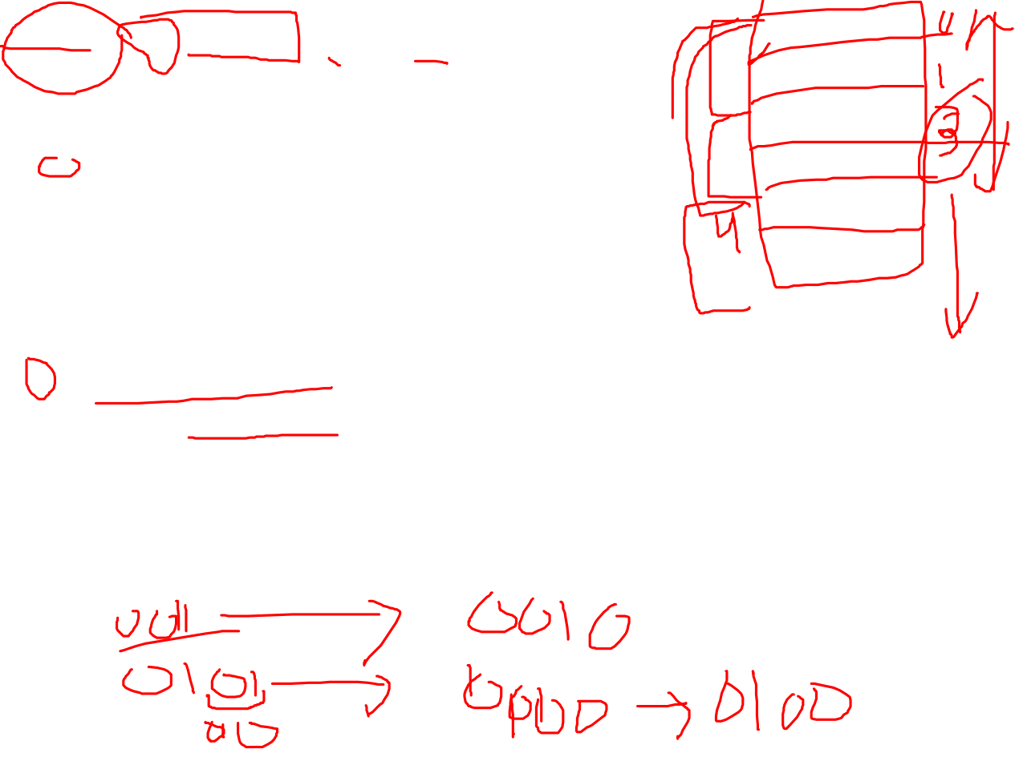
ARM Data Types
8 (byte), 16 (halfword), 32 (word) bits
Halfword and word accesses should be word aligned
Nonaligned access alternatives
Default
Treated as truncated
Bits[1:0] treated as zero for word
Bit[0] treated as zero for halfword
Load single word instructions rotate right word aligned data transferred by non word-aligned address one, two or three bytes
Alignment checking
Data abort signal indicates alignment fault for attempting unaligned access
Unaligned access
Processor uses one or more memory accesses to generate transfer of adjacent bytes transparently to the programmer

Slide 7

ARM Data Types
Unsigned integer interpretation supported for all types
Twos-complement signed integer interpretation supported for all types
Majority of implementations do not provide floating-point hardware
Saves power and area
Floating-point arithmetic implemented in software
Optional floating-point coprocessor
Single- and double-precision IEEE 754 floating point data types

Slide 8
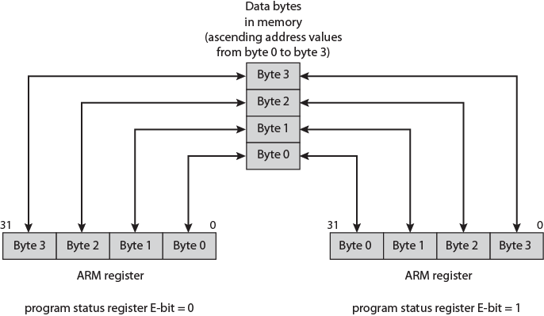

ARM Endian Support
E-bit in system control register
Under program control

Slide 9
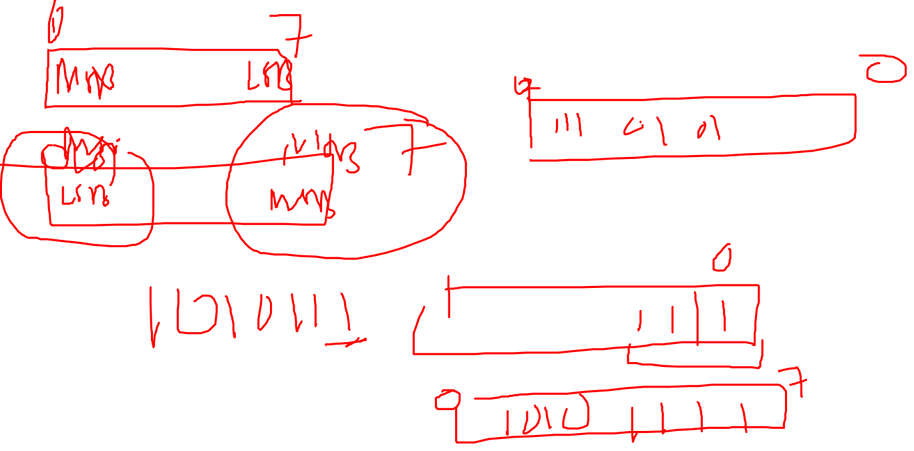
Byte Order (ENDIAN)
What order do we read numbers that occupy more than one byte
e.g. (numbers in hex to make it easy to read)
12345678 can be stored in 4x8bit locations as follows
Notes:
27

Slide 10
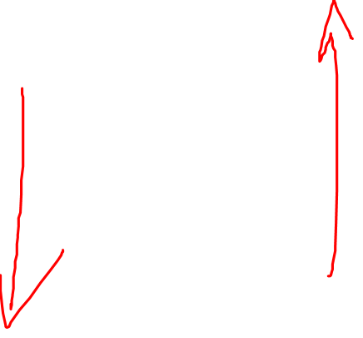
Byte Order (example)
Address Value (1) Value(2)
184 12 78
185 34 56
186 56 34
186 78 12
i.e. read top down or bottom up?
Notes:
28

Slide 11
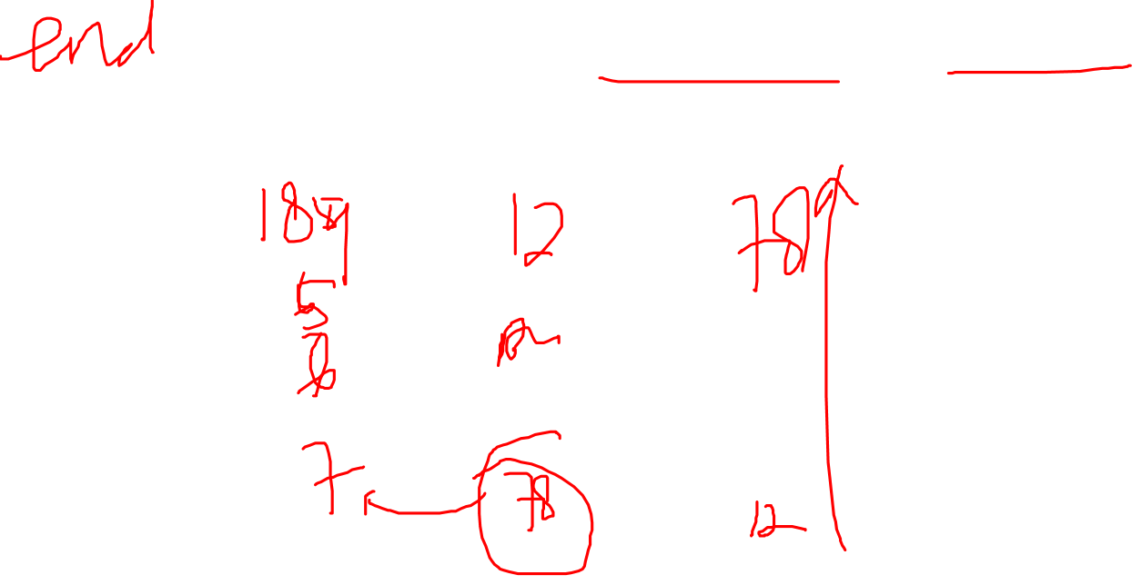
Byte Order Names
The problem is called Endian
The system on the left has the least significant byte in the highest address
This is called big-endian
The system on the right has the least significant byte in the lowest address
This is called little-endian
Notes:
29

Slide 12
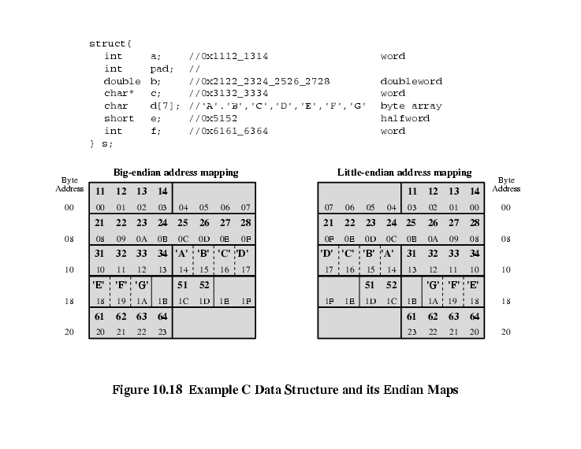
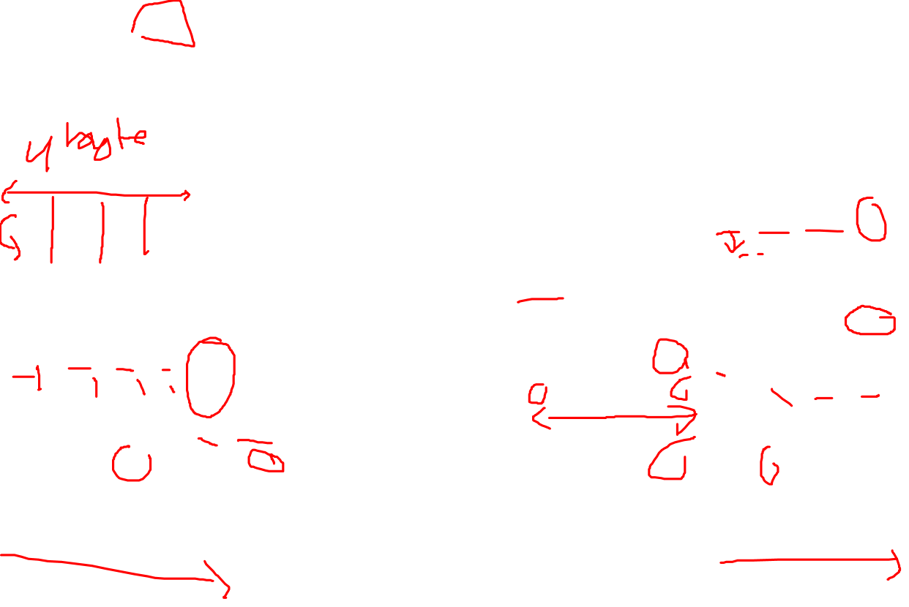
Example of C Data Structure

Slide 13
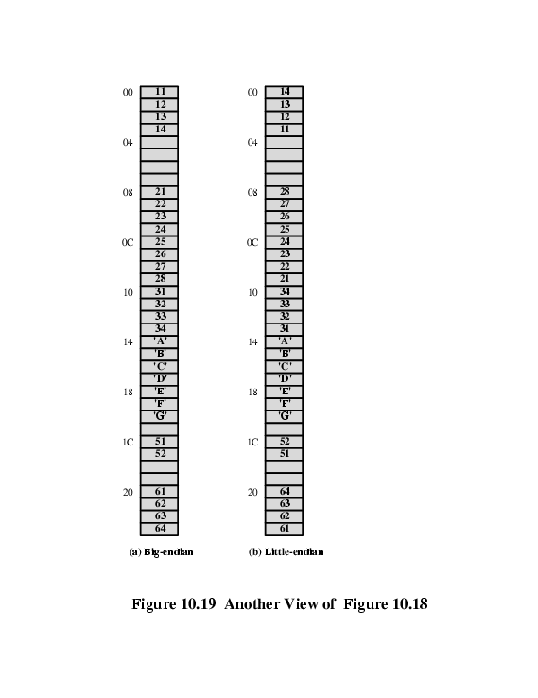

Alternative View of Memory Map

Slide 14
Types of Operation
Data Transfer
Arithmetic
Logical
Conversion
I/O
System Control
Transfer of Control
Notes:
18

Slide 15
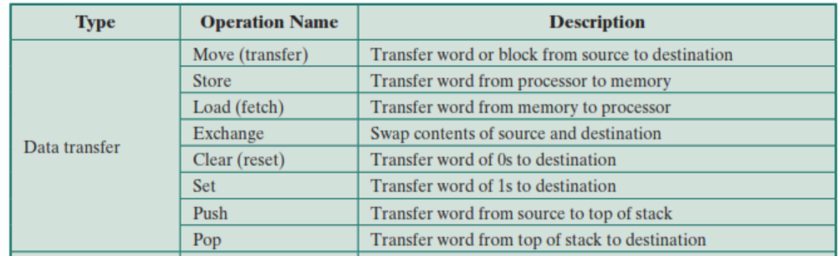

Data Transfer
Specify
Source
Destination
Amount of data
May be different instructions for different movements
e.g. IBM 370
Or one instruction and different addresses
e.g. VAX
Notes:
19

Slide 16
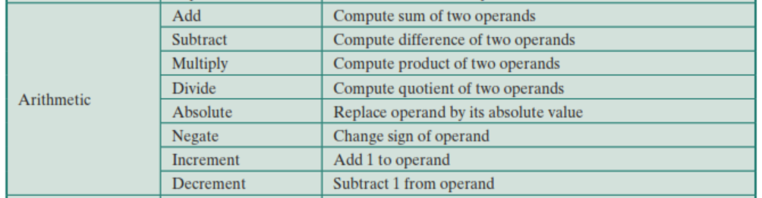

Arithmetic
Add, Subtract, Multiply, Divide
Signed Integer
Floating point ?
May include
Increment (a++)
Decrement (a--)
Negate (-a)
Notes:
20

Slide 17
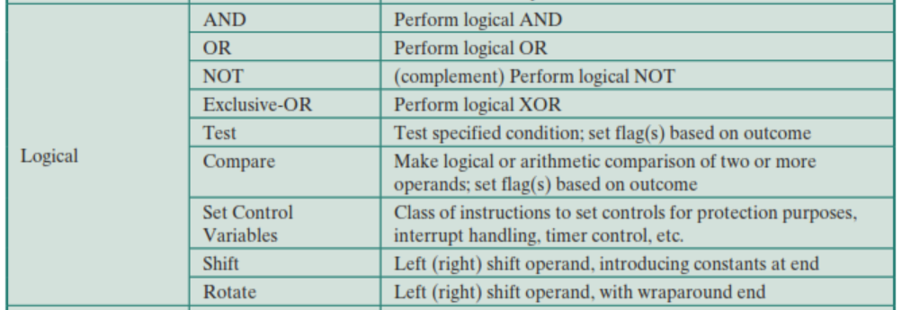
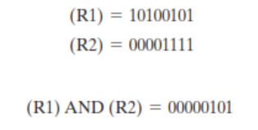
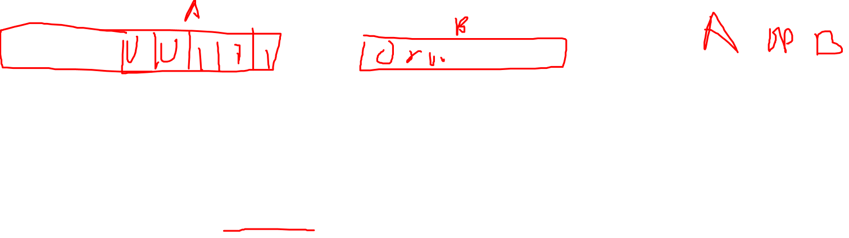
Logical
Bitwise operations
AND, OR, NOT
Notes:
21

Slide 18
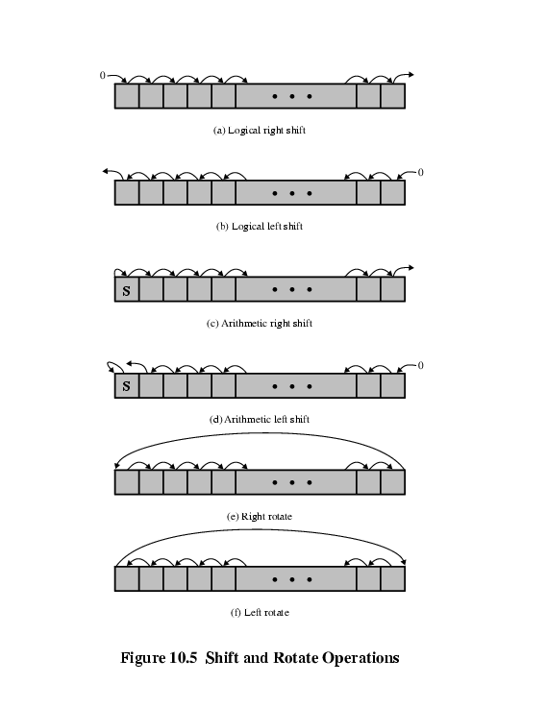
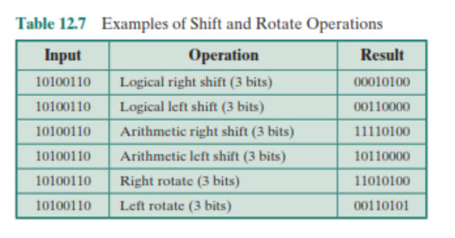
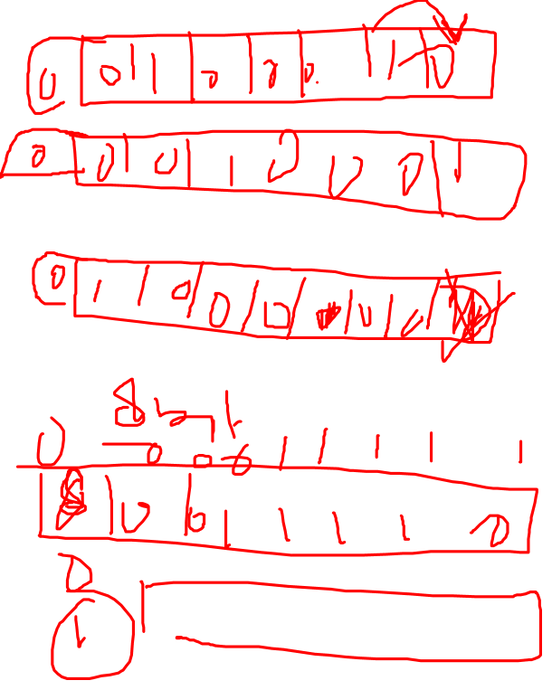
Shift and Rotate Operations

Slide 19
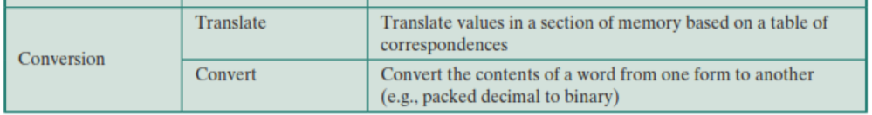

Conversion
E.g. Binary to Decimal
Notes:
22

Slide 20
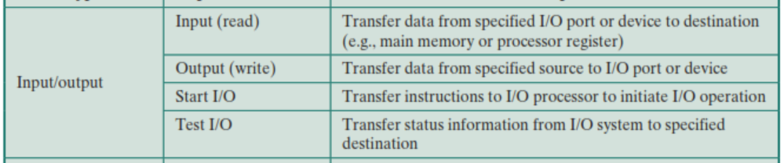
Input/Output
May be specific instructions
May be done using data movement instructions (memory mapped)
May be done by a separate controller (DMA)
Notes:
23

Slide 21

Systems Control
Privileged instructions
CPU needs to be in specific state
Ring 0 on 80386+
Kernel mode
For operating systems use
Notes:
24

Slide 22
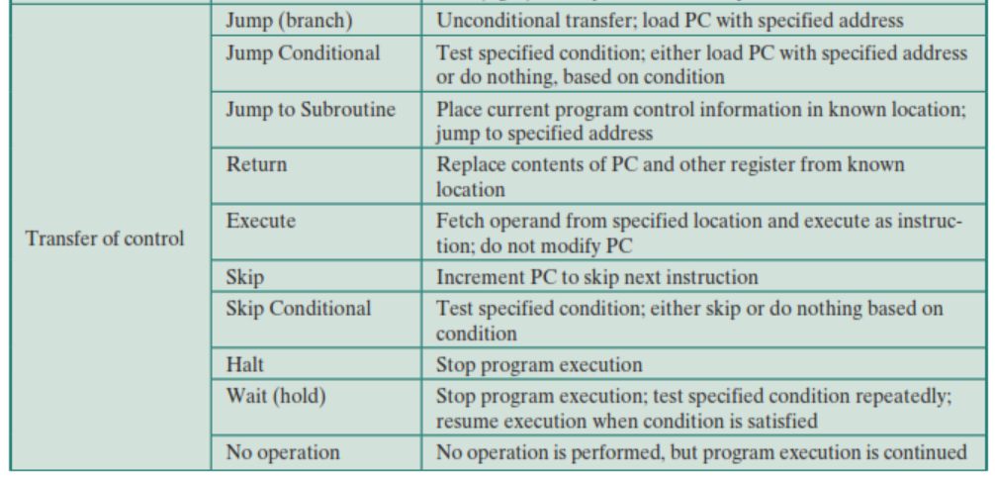

Transfer of Control
Branch
e.g. branch to x if result is zero
Skip
e.g. increment and skip if zero
ISZ Register1
Branch xxxx
ADD A
Subroutine call
c.f. interrupt call
Notes:
25

Slide 23
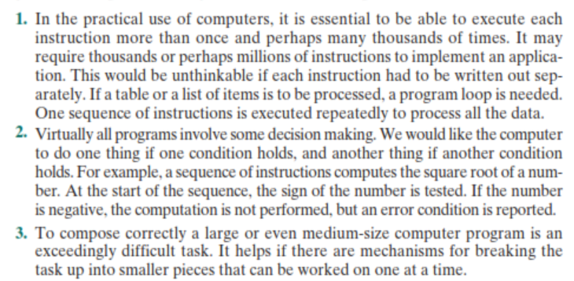

Slide 24
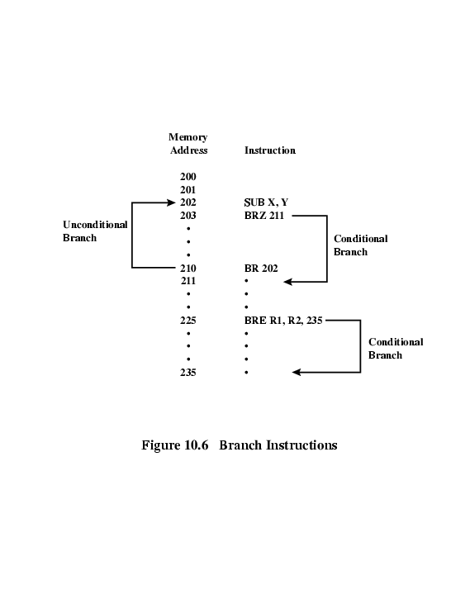
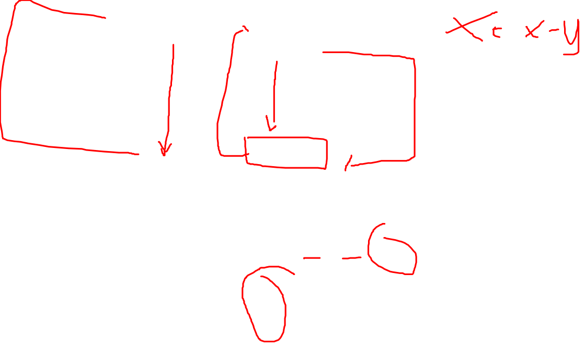
Branch Instruction

Slide 25
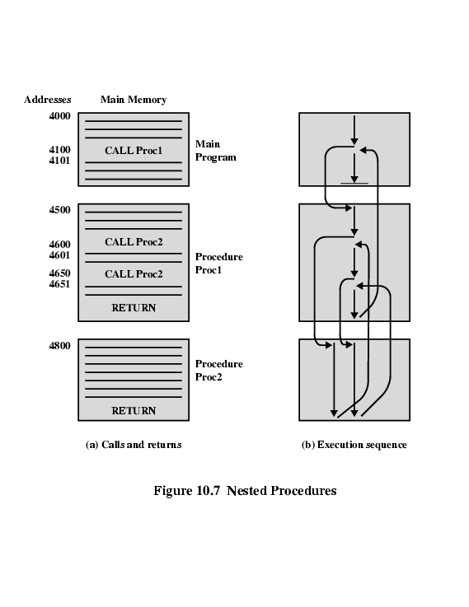
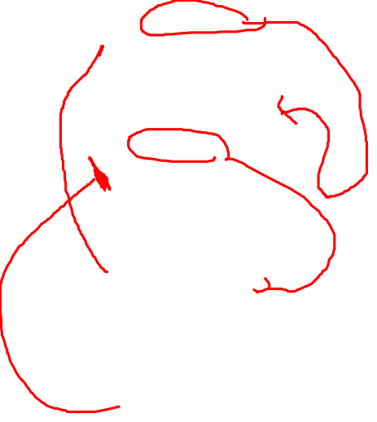
Nested Procedure Calls

Slide 26
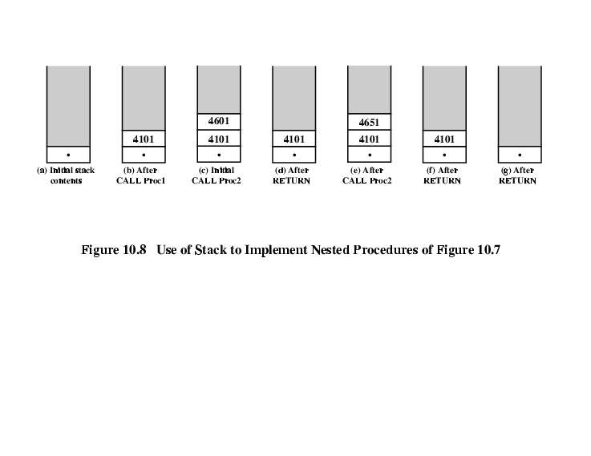
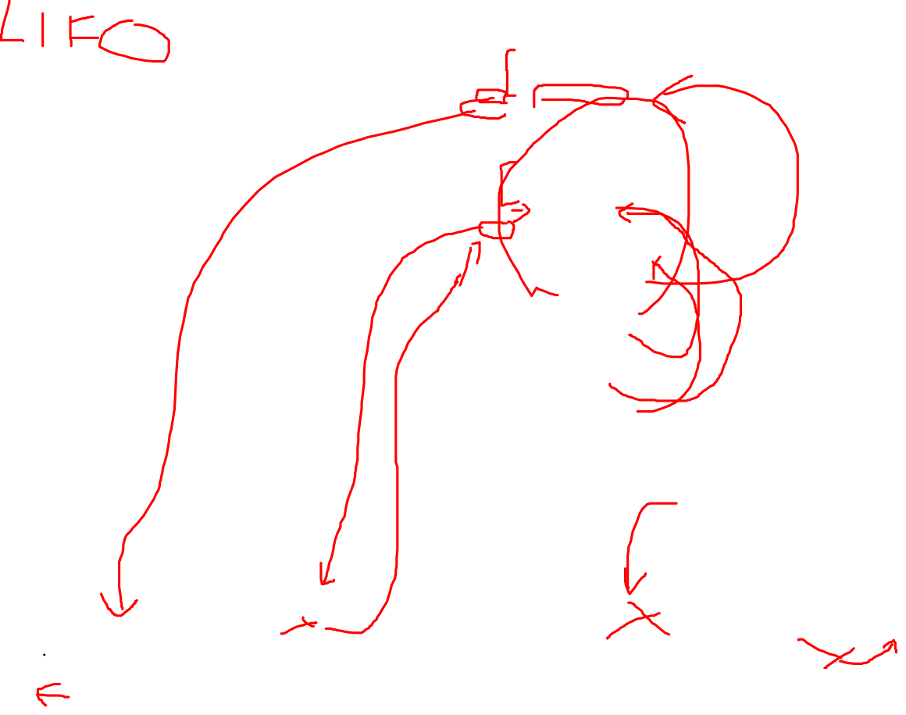
Use of Stack

Slide 27
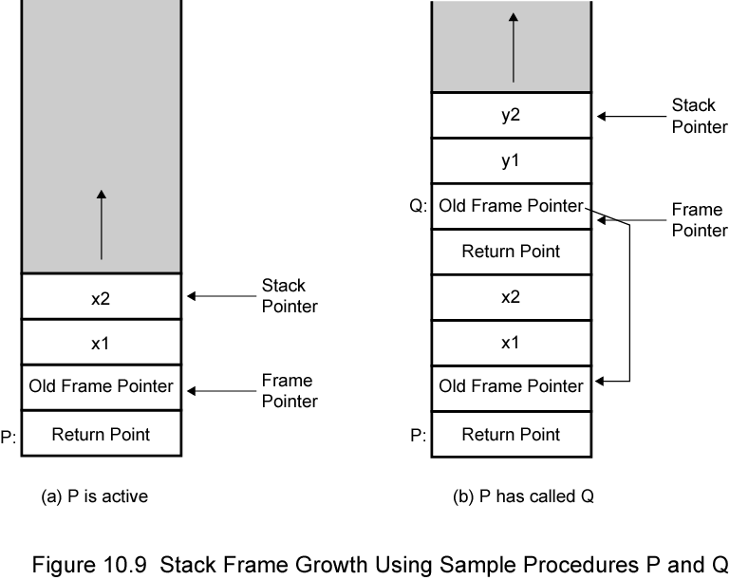
Stack Frame Growth Using Sample Procedures P and Q

Slide 28
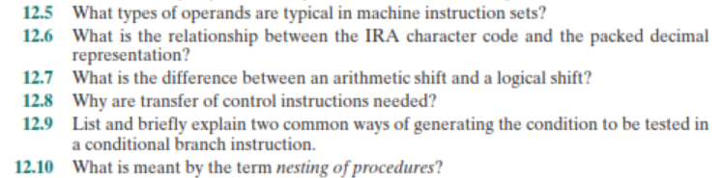
Standard…What Standard?
Notes:
30

Slide 29
